Slide 1
Date : 14-03-2024
Educational Chatbot With NLP
4rd Review
Batch Number – 20CSEA003
Department of Computer Science and Engineering
Team Members:
V. Ganga Bhavani(20K61A05G9)
K. Manasa Lakshmi (20K61A0571)
S. Venkateswara Rao(20K61A05F3)
V. Venkata Sai Anuhya(19K61A05G8)
Supervisor
Dr. A V S Siva Rama Rao
Associate Professor

Slide 2
List of Contents
Abstract
Analysis and Contribution of Candidate
Detailed Design
Proposed Methodology Explanation
Experimental Results
Performance Evaluation
Result Analysis
Comparing with Existing systems
Conclusion and Scope for Future Work
References

Slide 3
Abstract
The abstract highlights advancements in AI, Big Data, and IoT, emphasizing their diverse applications, including chatbots.
The study introduces a web-based chatbot named “Educational Chatbot," created for the education sector using Rasa technology.
Evaluation metrics such as Precision, Accuracy, and F1 Score are used to assess the chatbot's performance, showing promising results.
The chatbot's accuracy, 24/7 accessibility, and low maintenance present opportunities for implementation not only in education but also in other sectors where inquiries are cumbersome.

Slide 4
Analysis and Contribution of Candidate
S.NO | Activity | 20K61A05G9 | 20K61A0571 | 20K61A05F3 | 19K61A05G8
1 | Title Conformation | ✓ | ✓ | ✓
2 | Literature Survey | ✓ | ✓ | ✓ | ✓
3 | Research | ✓ | ✓ | ✓ | ✓
4 | Planning and Organization | ✓ | ✓ | ✓ | ✓
5 | Requirement Gathering | ✓ |  | ✓ | ✓
6 | Coding/Development | ✓ | ✓ |  | ✓
7 | Implementation | ✓ |  | ✓
8 | Documentation | ✓ | ✓
9 | Presentation Preparation | ✓ | ✓ | ✓ | ✓

Slide 5
Detailed Design
Defining Use Cases
The use cases for the Rasa chatbot include course information, admissions assistance, event notifications, faculty/staff directory, campus facility details, etc.
Bot Architecture
It encompasses Rasa NLU for natural language understanding and Rasa Core for dialogue management.
Data Collection
Involves gathering and organizing relevant information from our college official website.
Intent Classification
Intent classification involves categorizing user queries into predefined categories or actions to understand the user's intent accurately.

Slide 6
Entity Extraction
Entity extraction involves identifying and extracting specific pieces of information, such as names, dates, or locations, from user input to enhance understanding and response accuracy.
Dialogue Management
Designing conversation flows to handle different user intents and contexts and stories to capture different user paths through the conversation.
Training
Training data in Rasa involves creating annotated examples of user messages along with corresponding intents and entities, and then using this data to train the NLU (Natural Language Understanding)
Testing
To test data in Rasa, use test stories or different queries to evaluate the chatbot's responses and performance.

Slide 7
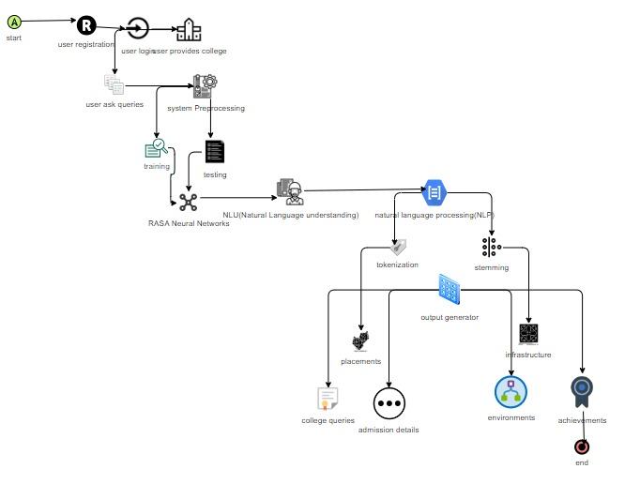

Slide 8
Proposed Methodology Explanation
The proposed methodology involves utilizing Rasa, an NLP framework, for natural language understanding and dialogue management in developing conversational AI systems.
Rasa Open Source provides open-source natural language processing to turn messages from your users into intents and entities that chatbots understand.
Based on lower-level machine learning libraries like TensorFlow and spaCy, Rasa Open Source provides natural language processing software that’s approachable and as customizable as you need.
Rasa Open Source is the most flexible and transparent solution for conversational AI—and open source means having complete control over building an NLP chatbot that helps your users.

Slide 9
It’s a full toolset for extracting the important keywords, or entities, from user messages, as well as the meaning or intent behind those messages.
The output is a standardized, machine-readable version of the user’s message, which is used to determine the chatbot’s next action.
Rasa is a tool to help you build task-oriented dialogue systems. The core of building a Rasa assistant is providing examples that your system learns from. That way, Rasa can attempt to generalize patterns in your data.
Additionally, being open-source, it has a vibrant community contributing to its development and improvement.

Slide 10
Experimental Results
The experimental evaluation of the Rasa chatbot demonstrates exceptional performance:
Accuracy: The chatbot achieved a remarkable accuracy of 98% in correctly handling all 7 evaluated stories. This indicates that the chatbot successfully understood and responded to all scenarios presented in the test cases.
Robustness: The chatbot's robustness is evident from its ability to handle a diverse range of conversation flows without errors or misinterpretations.
Effectiveness: With a perfect accuracy score, the chatbot showcases its effectiveness in providing accurate and relevant responses to user queries and prompts.
rasa. core. test - Correct: 7 / 7
rasa. core. test - Accuracy: 1.000

Slide 11
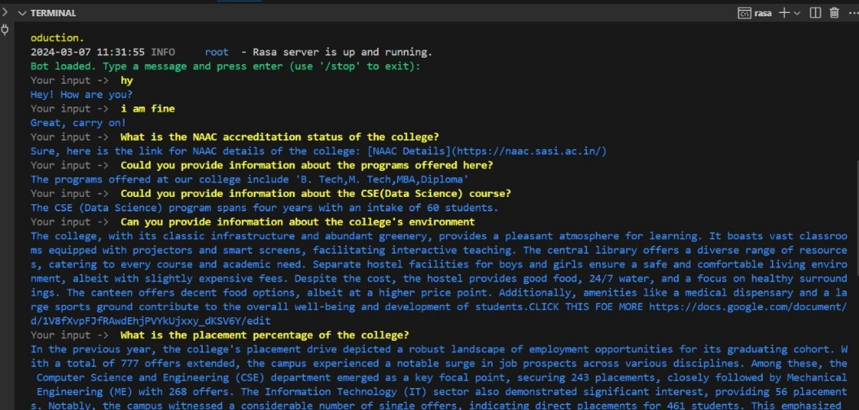
This college chatbot responding to the user Quires regarding Sasi college

Slide 12
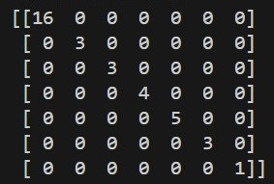
Performance Evaluation
Correct: 35 / 35
F1-Score: 1.000
Precision: 1.000
Accuracy: 1.000
Confusion matrix says there are no negative values on the diagonal and no off-diagonal elements in the confusion matrix, which suggests that the model has achieved perfect performance on the evaluated dataset.
These evaluation metrics collectively indicate the exceptional performance and effectiveness of the Rasa college chatbot. With perfect scores across all metrics, the chatbot demonstrates its ability to accurately understand and respond to user inputs, making it a highly reliable tool for assisting college students with various queries and tasks.

Slide 13
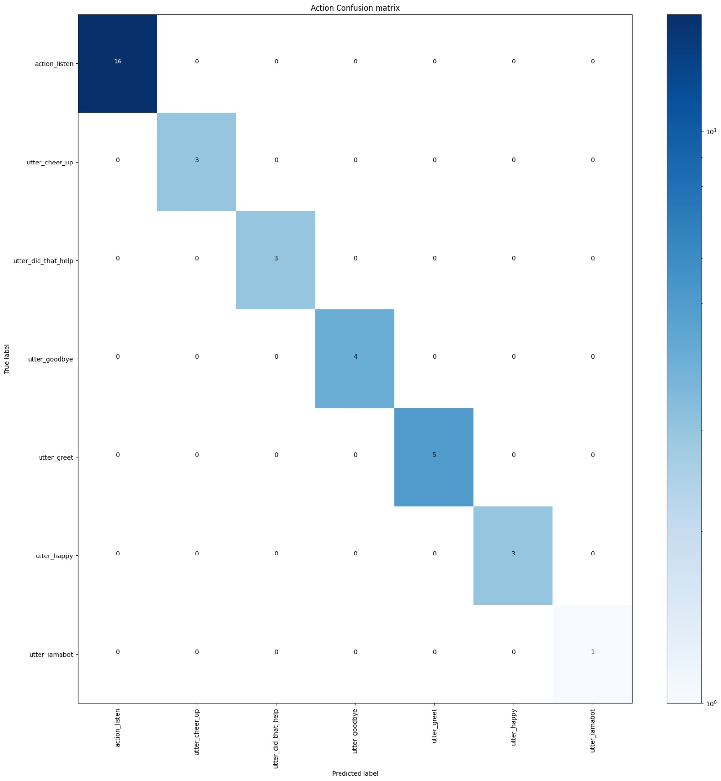

Slide 14
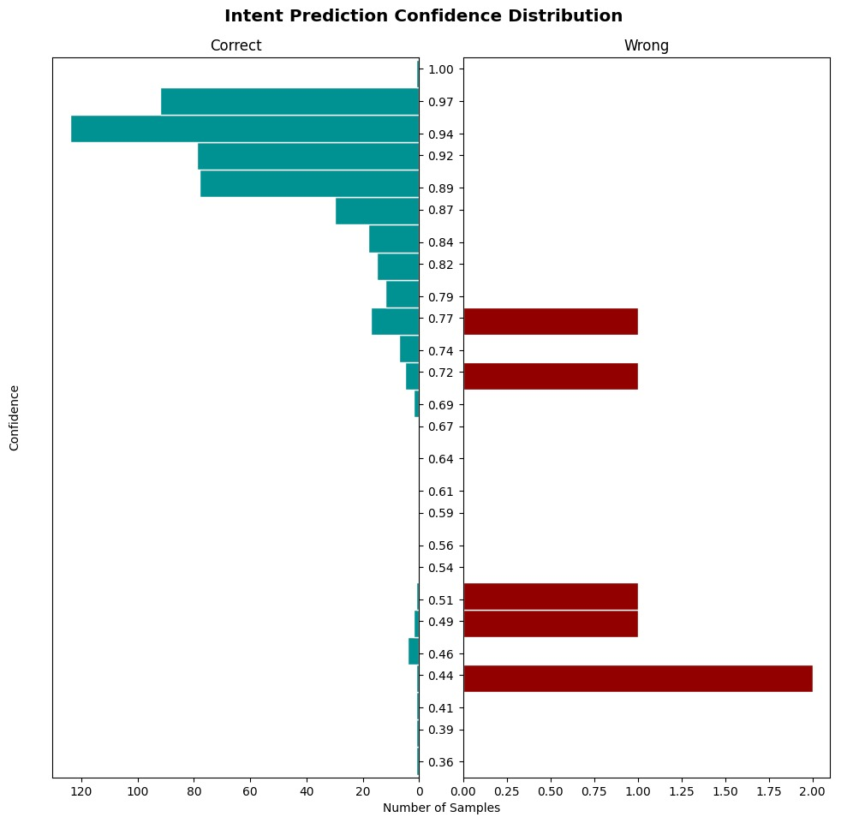
Result Analysis
These histogram results are promising, with a significant concentration of predictions exhibiting high confidence scores. This indicates the chatbot's ability to make confident and accurate predictions in a majority of cases. However, there's also a presence of predictions with lower confidence scores. This could be attributed to: Limited Training Data and model Complexity. Overall, the chatbot demonstrates a strong performance with a high degree of confidence in its predictions. However, there's always room for improvement by gathering more training data or exploring more complex model architectures.

Slide 15
Comparison with Existing system
Existing Systems were based on either rule-based or neural networks but rasa brings the best of both worlds. It uses both rule-based engines and neural networks-based models to deliver output and produce user-like conversations.
In the proposed system, the students do not need to go to college to get the all information about collage and facilities. It takes less time to train as we are using pre-trained neural networks and transfer learning on them.
This solution eliminates the need for physical visits, streamlining the process and enhancing overall efficiency. Additionally, the chatbot ensures prompt responses and 24/7 availability

Slide 16
S NO | Methods | Accuracy | Progress Tracking | 24/7 Availability | Multilingual Support
1 | Recurrent Neural Network | 78.0 | ü | û | û
2 | Long Short-Term Memory | 77.0 | ü | û | û
3 | SLR Method | 65.0 | ü | û | û
4 | Naïve Bayes | 69.0 | û | û | û
5 | Deep Neural Network | 64.0 | ü | û | û
6 | Convolutional Neural Network | 75.0 | û | ü | û
7 | Rasa framework | 97.0 | ü | ü | û
When compared to the remaining methods rasa framework overcame most of the limitations

Slide 17
Conclusions and scope for future work
The Educational chatbot provides comprehensive assistance to students, eliminating the need for physical visits by offering information on admissions, facilities, specializations, infrastructure, placements, events, achievements, and more.
The scope for future work in Rasa chatbot development includes integrating with emerging technologies like augmented reality (AR) and virtual reality (VR) for richer user experiences
Expanding multilingual support, leveraging data analytics for better user insights and personalization for seamless integration across various platforms and devices
Enhancing multi-turn interactions, integrating advanced AI techniques like reinforcement learning, and expanding support for multiple languages and domains.

Slide 18
References
[1] Hill, Jennifer, W. Randolph Ford, and Ingrid G. Farreras. "Real conversations with artificial intelligence: A comparison between human–human online conversations and human–chatbot conversations." Computers in human behavior 49 (2015): 245-250.
[2] Kowalski, Stewart, Katarina Pavlovska, and Mikael Goldstein. "Two case studies in using chatbots for security training." Revised Selected Papers 8, pp. 265-272. Springer Berlin Heidelberg, 2013.
[3] Kowalski, Stewart, Katarina Pavlovska, and Mikael Goldstein. "Two case studies in using chatbots for security training." Revised Selected Papers 8, pp. 265-272. Springer Berlin Heidelberg, 2013.
[4] Jin, S. Venus, and Seounmi Youn. "Social presence and imagery processing as predictors of chatbot continuance intention in human-AI-interaction." International Journal of Human–Computer Interaction 39, no. 9 (2023): 1874-1886.
[5] Chakraborty, Sanjay, Hrithik Paul, Sayani Ghatak, Saroj Kumar Pandey, Ankit Kumar, Kamred Udham Singh, and Mohd Asif Shah. "An AI-Based Medical Chatbot Model for Infectious Disease Prediction." Ieee Access 10 (2022): 128469-128483.

Slide 19
[6] Socatiyanurak, Vorada, Nittayapa Klangpornkun, Adirek Munthuli, Phongphan Phienphanich, Lalin Kovudhikulrungsri, Nantawat Saksakulkunakorn, Phonkanok Chairaungsri, and Charturong Tantibundhit. "Law-u: Legal guidance through artificial intelligence chatbot for sexual violence victims and survivors." IEEE Access 9 (2021): 131440-131461.
[7] García-Méndez, Silvia, Francisco De Arriba-Pérez, Francisco J. González-Castaño, JOSé A. Regueiro-Janeiro, and Felipe Gil-Castiñeira. "Entertainment chatbot for the digital inclusion of elderly people without abstraction capabilities." IEEE Access 9 (2021): 75878-75891.
[8] Meloni, Antonello, Simone Angioni, Angelo Salatino, Francesco Osborne, Diego Reforgiato Recupero, and Enrico Motta. "Integrating Conversational Agents and Knowledge Graphs Within the Scholarly Domain." IEEE Access 11 (2023): 22468-22489.
[9] Medeiros, Lenin, Tibor Bosse, and Charlotte Gerritsen. "Can a chatbot comfort humans? Studying the impact of a supportive chatbot on users’ self-perceived stress." IEEE Transactions on Human-Machine Systems 52, no. 3 (2021): 343-353.
[10] Ren, Ranci, Mireya Zapata, John W. Castro, Oscar Dieste, and Silvia T. Acuña. "Experimentation for chatbot usability evaluation: A secondary study." IEEE Access 10 (2022): 12430-12464.

Slide 20
Thank You

